Slide 1

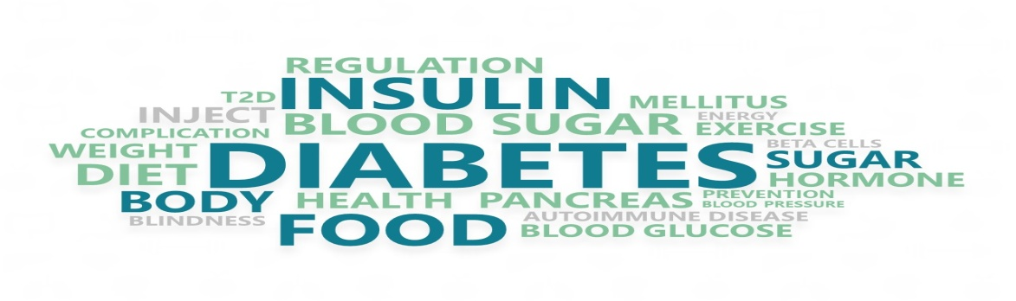
Healthcare capstone project
Trainee: Karima SADAT

Slide 2
Problem Statement
Based on a dataset provided by NIDDK (National Institute of Diabetes and Digestive and Kidney Diseases) that contains a number of diagnostic measurements , we will build a model to accurately predict whether or not a patient has diabetes.

Slide 3
Dataset Description
Dataset is originally from the National Institute of Diabetes and Digestive and Kidney Diseases.
All patients are females of at least 21 years old and of Pima Indian heritage
Dataset has 768 rows and 9 variables.
The dataset consists of several medical predictor variables (independent variables) and one target (dependent) variable

Slide 4
Variables
 | Variables | Description
Independent variables | Pregnancies | Number of times pregnant
 | Glucose | Plasma glucose concentration in an oral glucose tolerance test
 | BloodPressure | Diastolic blood pressure (mm Hg)
 | SkinThickness | Triceps skinfold thickness (mm)
 | Insulin | Two hour serum insulin
 | BMI | Body Mass Index
 | DiabetesPedigreeFunction | Diabetes pedigree function
 | Age | Age in years
dependent variables | Outcome | Class variable (either 0 or 1).
We are working on a binomial classification problem

Slide 5
Basic Data Exploration
Pregnancies values range is 0 to 17
Age goes from 21 to 81 years
Glucose, BloodPressure, SkinThickness, Insulin, BMI min value is 0 which are biologically not possible and represent missing values .
Leaving these values as they are can reduce the predictive power of the model . Hence, we should treat them

Slide 6
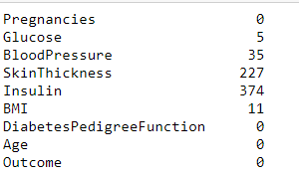
Missing values treatment
Count of missing values for Glucose, BloodPressure, Insulin, BMI, and SkinThickness:
Missing values were treated by median imputation

Slide 7
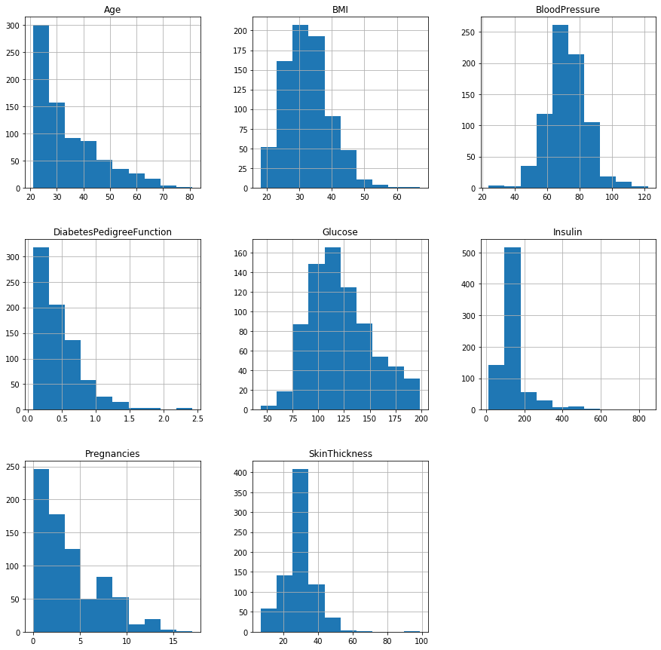
Independent variable distribution
Independent variables are not normally distributed.
Some variables have extreme
Values e.g. Skinthikness,Insulin
The scale differs from variable to another e.g. Age and Insulin
We need to transform data to adjust the values that are in a major scale into the common one

Slide 8
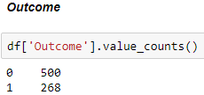
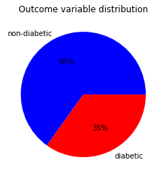
Dependent variable distribution
Dependent variables “Outcome” has 268 (35%) diabetics and 500 (65%) non-diabetic patients. Data is slightly imbalanced.
35% of diabetics should provide enough cases for a good classification model.
For most machine learning techniques, little imbalance is not a problem.

Slide 9
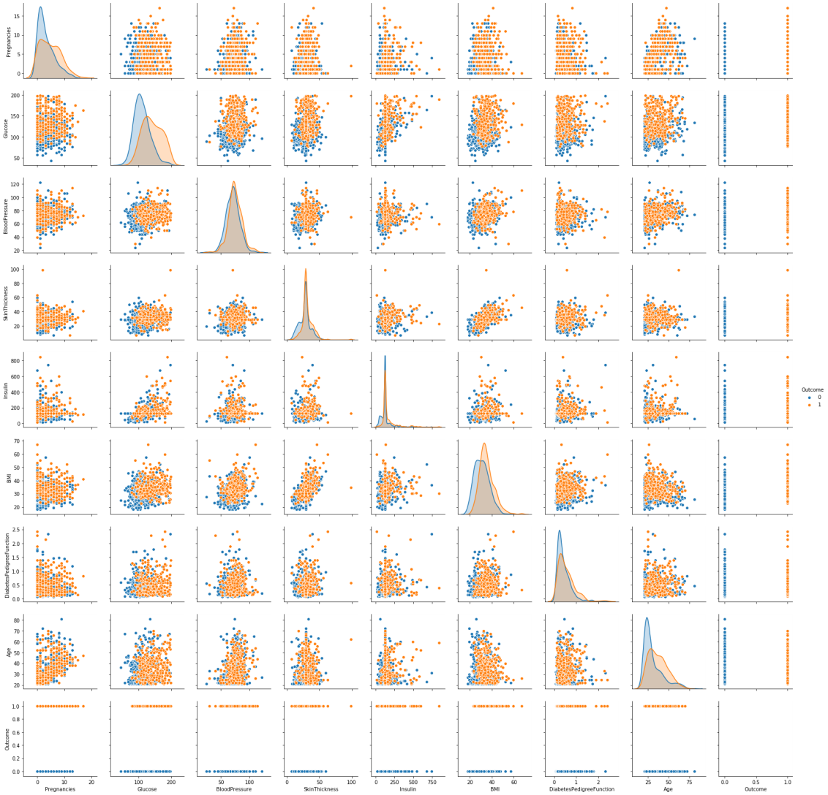
Multivariate distributions
From the scatter plots, a High Glucose, BMI independently from other variables causes diabetes.
BMI & SkinThickness, Glucose & Insulin, Pregnancies & Age are positively correlated

Slide 10
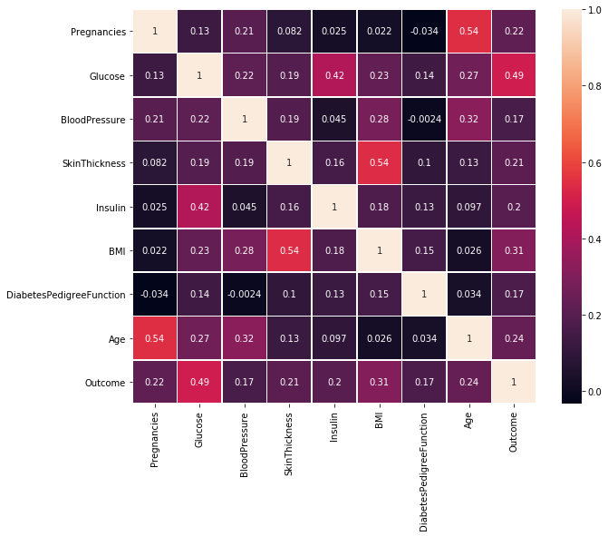
Correlation analysis
From the correlation analysis:
We couldn't find a strong relationship between two variables
A moderate positive linear relationship exists:
For Pregrancies with age
For Glucose with insulin and outcome
For Skinthikness with BMI
For Insulin with glucose and outcome

Slide 11
Model building
Model building strategy:
After Separating the independent and dependent features, we will Standardize X variables and then start the model building. We will use classification accuracy to evaluate models.
First models: Logistic regression, SVM, Decision Tree, Random Forest, Naive Bayes models with 70/30 data split and default classifier values. Check the accuracy of each classifier using confusion matrix accuracy_score.
Second models: Build Logistic regression, SVM, Decision Tree, Random Forest, Naive Bayes models with cross validation. we will check how test/training split using cross validation will affect the predictive power accuracy of each model.
Next step: We will select two winning models depending of the cross validation accuracy and tune them to determine the hyperparamers that will give us the best accuracy. for that I will use cross validation and gridsearch.
Calculate ROC_AUC , sensitivity, specificity and FPR scores for the models to determine the most performant.

Slide 12
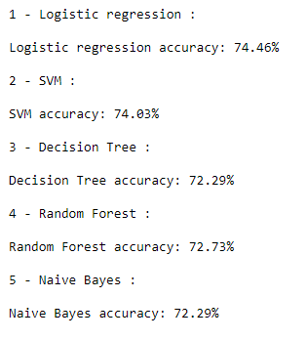
Build Logistic regression, SVM, Decision Tree, Random Forest, Naive Bayes models with 70/30 split
From the accuracy report, Logistic Regression is the most accurate (74.46%) followed by SVM (74.03%)

Slide 13
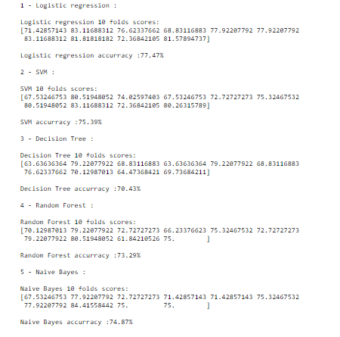
Build Logistic regression, SVM, Decision Tree, Random Forest, Naive Bayes models with cross validation 10k
From the accuracy report, Logistic regression is the most accurate (77.47%), followed by SVM(75.39%) then Naive biase (74.87%).
If we look at individual results by fold, several of them are getting more than 80% accuracy.
The models obtained using cross validation are more accurate than the models of the 70/30 split

Slide 14
Logistic regression and SVM model tuning
SVM Model:
Hyper parameters {'C': 100, 'gamma': 0.001, 'kernel': 'rbf'} for SVM model gave us an accuracy of 77.60%. better than 75.39% obtained using only cross validation 10k
Using this SVM model , we predicted 77.60% correctly out of all the classes.
Logistic Regression:
Tuned parameters didn't give any improvement in the accuracy .
So, using this logistic regression model , we predicted 77.47% correctly out of all the classes.

Slide 15

Build KNN model with 10-fold (cv=10) cross-validation and K=5 (n_neighbors=5)
From the accuracy report, KNN model with 10-fold (cv=10) cross-validation and K=5 (n_neighbors=5) accuracy was 73,82%

Slide 16
KNN model tuning: search for an optimal value of K for KNN
These hyper parameters (algorithm='auto', leaf_size=30, metric='minkowski', metric_params=None, n_jobs=None, n_neighbors=25, p=2,weights='uniform') for KNN model gave us an accuracy of 79.30%.
Using this KNN model , we predicted 79.30% correctly out of all the classes.

Slide 17
Models comparison
Model | Accuracy | Sensitivity | precision | specificity | FPR | auc
SVM | 0.776042 | 0.559701 | 0.735294 | 0.892 | 0.11 | 0.725851
Logistic Regression | 0.77474 | 0.570896 | 0.725118 | 0.884 | 0.12 | 0.727448
KNN | 0.792969 | 0.61194 | 0.748858 | 0.89 | 0.11 | 0.75097
Accuracy : KNN has a higher accuracy . 79% of correct predictions
Sensitivity: When the actual value is positive, how often is the prediction correct?
KNN is more sensitive. 61% were predicted correctly out of the positive class
Precision: When a positive value is predicted, how often is the prediction correct?
KNN is more precise. 75% positive value predicted were correct

Slide 18
Models comparison (contd..)
Model | Accuracy | Sensitivity | precision | specificity | FPR | auc
SVM | 0.776042 | 0.559701 | 0.735294 | 0.892 | 0.11 | 0.725851
Logistic Regression | 0.77474 | 0.570896 | 0.725118 | 0.884 | 0.12 | 0.727448
KNN | 0.792969 | 0.61194 | 0.748858 | 0.89 | 0.11 | 0.75097
Specificity: When the actual value is negative, how often is the prediction correct?
The three classifier are Highly specific
FPR: When the actual value is negative, how often is the prediction incorrect?
Three classifiers have around 11% of negative values incorrectly classified as positive(FP), from the total amount of actual negative values in the dataset.

Slide 19
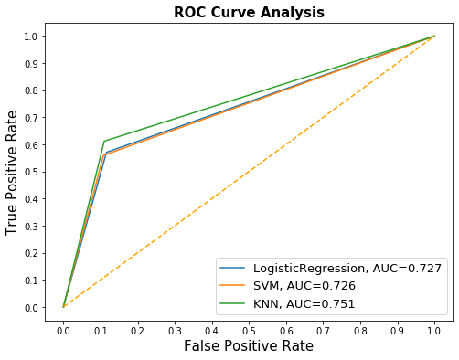
Models comparison (contd..)
AUC: is the percentage of the ROC plot that is underneath the curve. It represents the likelihood that your classifier will assign a higher predicted probability to the positive observation.
KNN has a higher AUC. Hence it’s the most performant

Slide 20
Conclusion
After comparing the three classifiers, KNN scores were the highest compared to the two others. Hence it’s the most performant

Slide 21
Tableau visualization
https://public.tableau.com/profile/kari8197#!/vizhome/A-PR/Dashboard1?publish=yes

Slide 22


